Slide 1
Leveraging DFS
Yusif Affara, Chase Cardon, Andrew Fish, Marcel Hujanen, Luke Ponticello

Slide 2
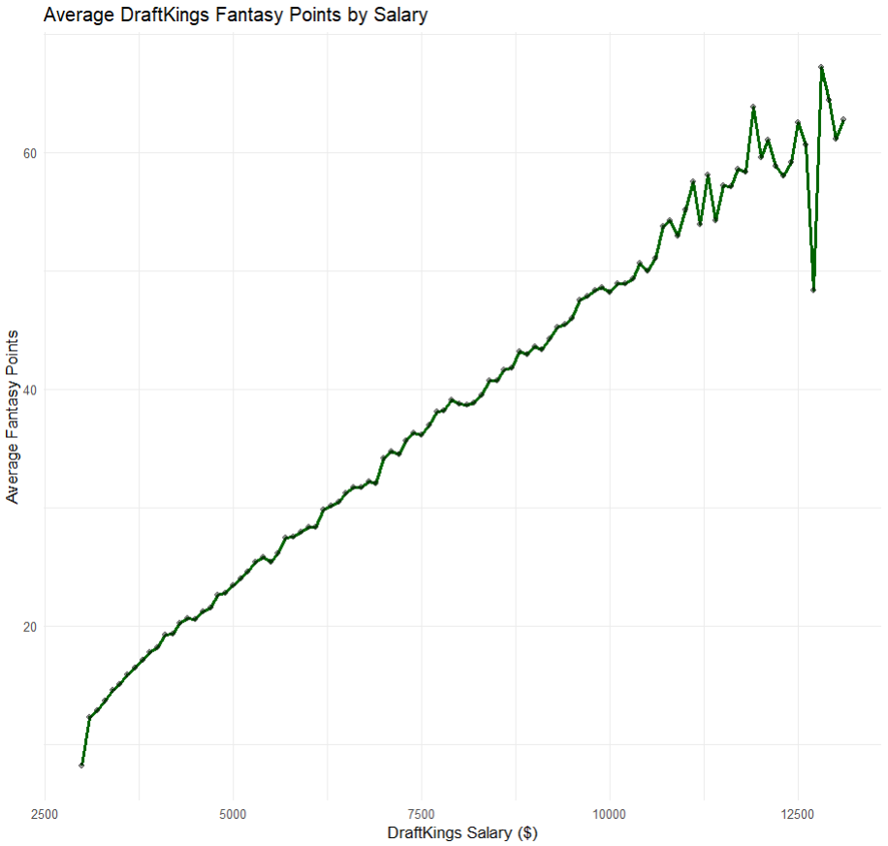
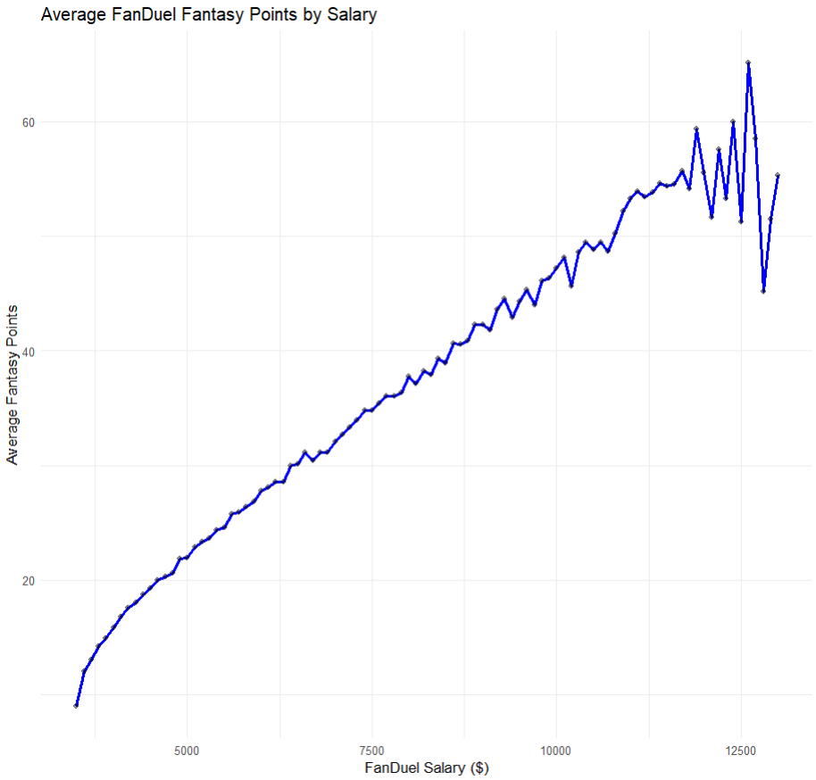
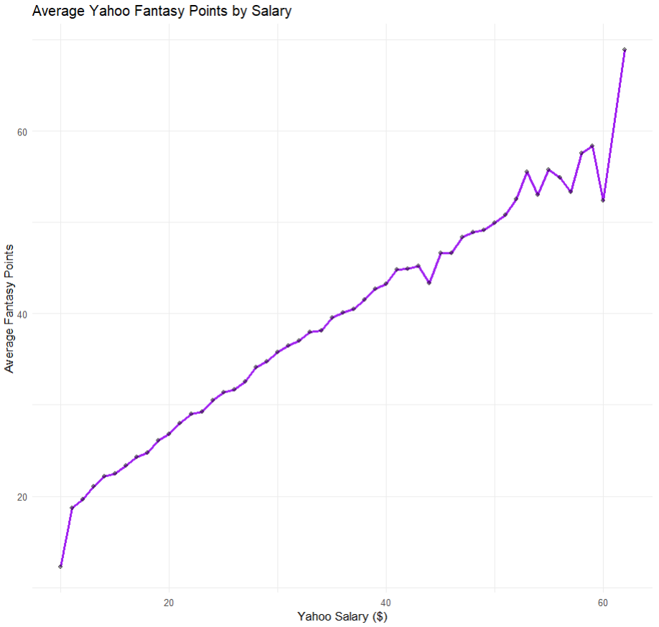
Market Efficiency: Points ~ Salary
Each market shows a strong, statistically significant correlation between salary and fantasy points, suggesting salary is a strong predictor of player performance
Very low-salary players may skew results slightly due to extremely low, and occasionally negative fantasy point production
Salary structures across DraftKings, FanDuel, and Yahoo appear efficient
Salary coefficients when only looking at Points ~ Salary
DraftKings ~ +0.0056 or 0.56 points per $100
FanDuel ~ +0.0057 or 0.57 points per $100
Yahoo ~ +1.02 or 1.02 points per $1
Variance in points increases as salaries get higher

Slide 3
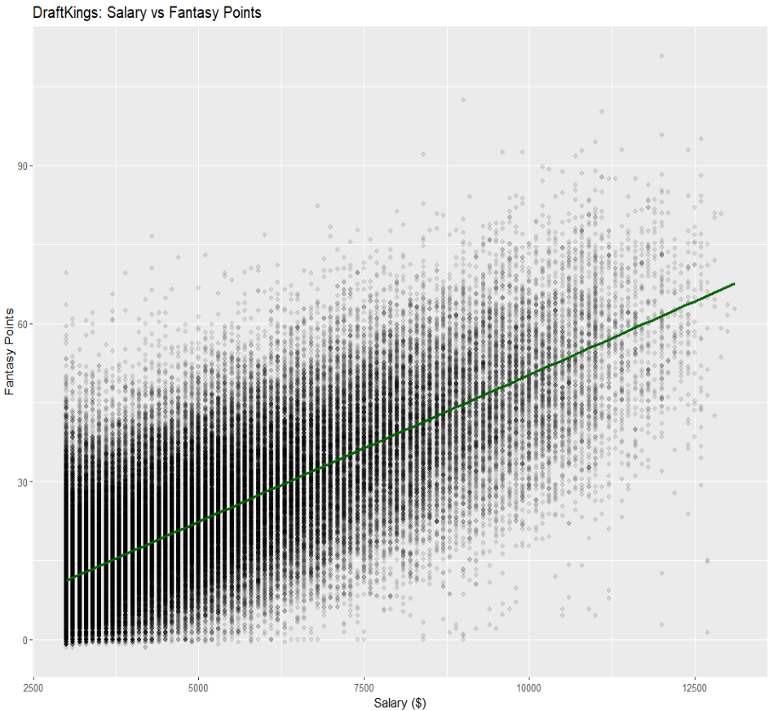
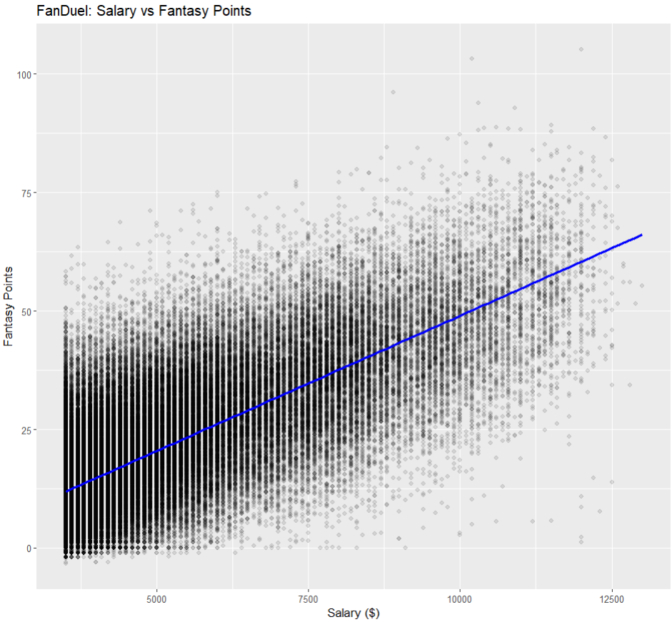
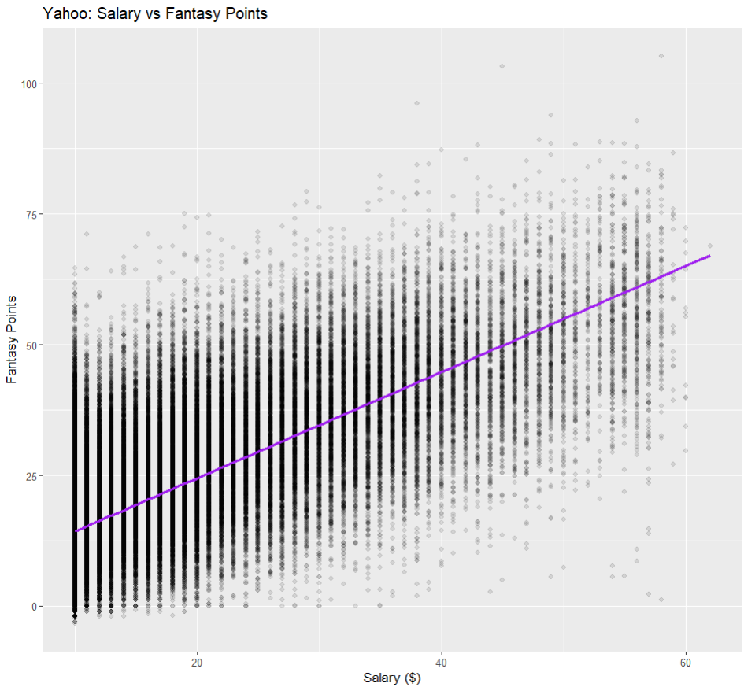
Market Efficiency: Factoring in other variables
When adding more variables, the market presents some inefficiencies
Starter (Yes (-)), Venue (Road (-)), Minutes (+), Usage (+), Days rest (+), and multiple opponents had statistically significant results
Suggesting that rosters created using these inefficiencies may outperform others
*Days rest was not statistically significant in the Yahoo market

Slide 4
Modeling Fantasy Points
 | DraftKings | FanDuel | Yahoo | F-Test
Intercept | -5.528*** | -8.002*** | 4.21433*** | NA
draftsal | 0.00558*** | NA | NA | 1.3708 x e¹⁰***
fansal | NA | 0.005699*** | NA | 1.4209 x e¹⁰***
yahsal | NA | NA | 1.0133*** | 8853.1***
Examing relationship between Salary and Points – expecting to pay more for more points
According to the F-Tests there is a strong linear relationship between Salary and Points across all platforms
 | DraftKings | FanDuel | Yahoo
Intercept | -13.86*** | -14.41*** | -9.643605***
draftsal | 0.002393*** | NA | NA
fansal | NA | 0.002442*** | NA
yahsal | NA | NA | 0.438634***
MINUTES | 0.8486*** | 0.8406*** | 0.862623***
usage | 0.2857*** | 0.2502*** | 0.242607***
HomeGame | 0.3726*** | 0.3681*** | 0.378184***
starter | -2.366*** | -2.099*** | -2.006084***
daysrest | 0.009269*** | 0.01032*** | 0.001952
Next added in additional factors that could affect performance
Across all platforms MINUTES, usage, HomeGame, starter, and daysrest were significant at the 0.1% level
daysrest only not significant for Yahoo
Using AIC to compare the two different models for each platform
AIC preferred the model with more variables in all cases

Slide 5
Leveraging Points and Salary
Players to Target >30% Overperform Rate
Players to Avoid [20%, 28%] Underperform Rate
Giannis Antetokounmpo
Nikola Jokic
Luca Doncic
Anthony Davis
Players above have the highest salaries available
Averaging 50-55 pts
Sleepers – [25%, 30%] Overperform Rate
Rudy Gobert
Jonas Valanciunas
Hassan Whiteside
Players above are cheaper alternatives than the first set
Still averaging 30-35 pts
Tim Hardaway Jr
Gart Trent Jr
Tyler Herro
RJ Barrett
Many underperformers are possible sleepers
Mid to lower end of the price range
Players that were more than 10 pts away from their predicted value
10 higher considered overperformance
10 lower considered underperformance
Organized based on the rate they over/under perform
Calculated average salary and pts scored
Leveraging this will highlight players to target and to avoid
Overall found that you get what you pay for
The top players to overperform are the higher valued salary players

Slide 6
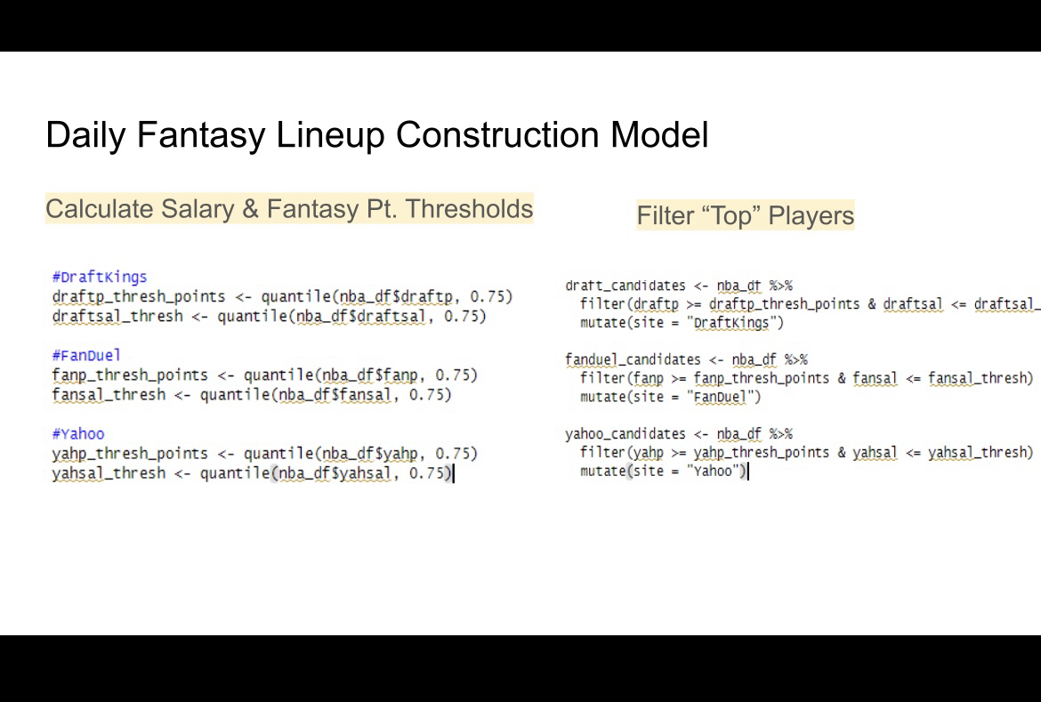

Slide 7
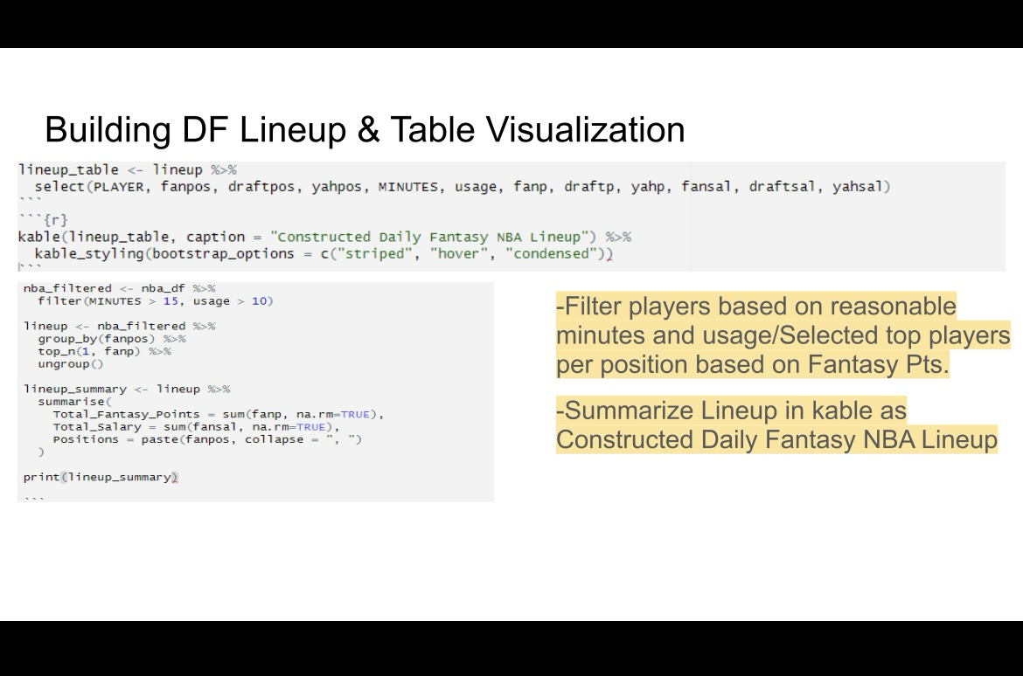

Slide 8
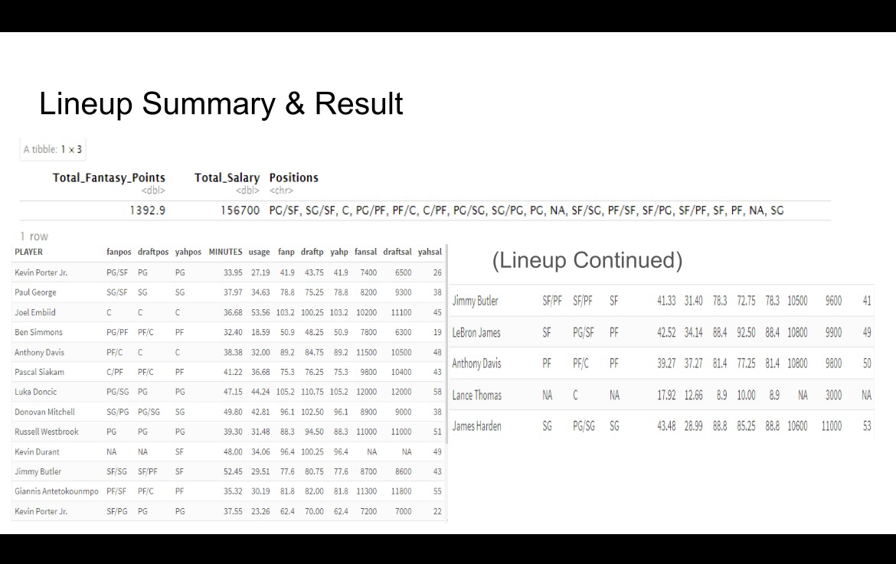

Slide 9
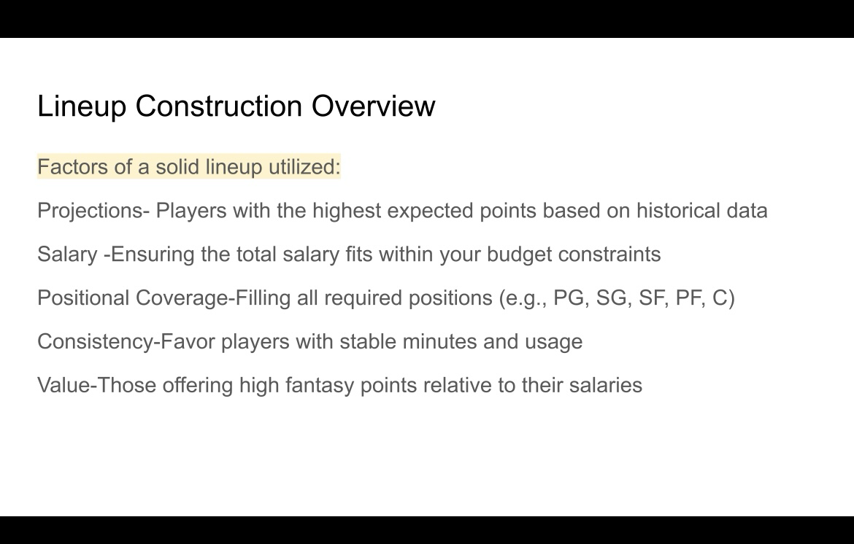

Slide 10
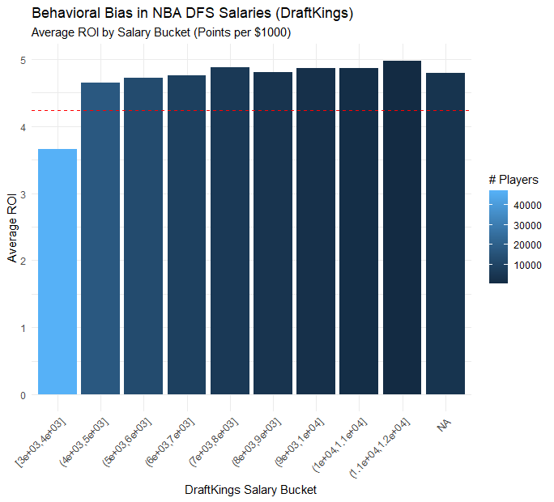
Behavioral Biases
Key Components:
X-axis: Salary buckets
Y-axis: Average ROI — measured in fantasy points per $1,000 of salary
Bars: Represent average ROI for each salary group
Color scale: Number of players in each bucket (lighter blue = more players)
Red dashed line: Overall average ROI across all buckets (reference point)
Interpretation:
Lowest Salary Bucket ([3k–4k]):
Significantly underperforms with ROI below the red line (~3.6).
Suggests cheap players typically underdeliver in fantasy points per dollar.
Middle & Higher Salary Buckets (4k–12k):
Consistently above the average ROI (red line).
ROI ranges between ~4.6–5.0 fantasy points per $1,000 salary.
The best ROI is in the $10,000–$11,000 range.

Slide 11
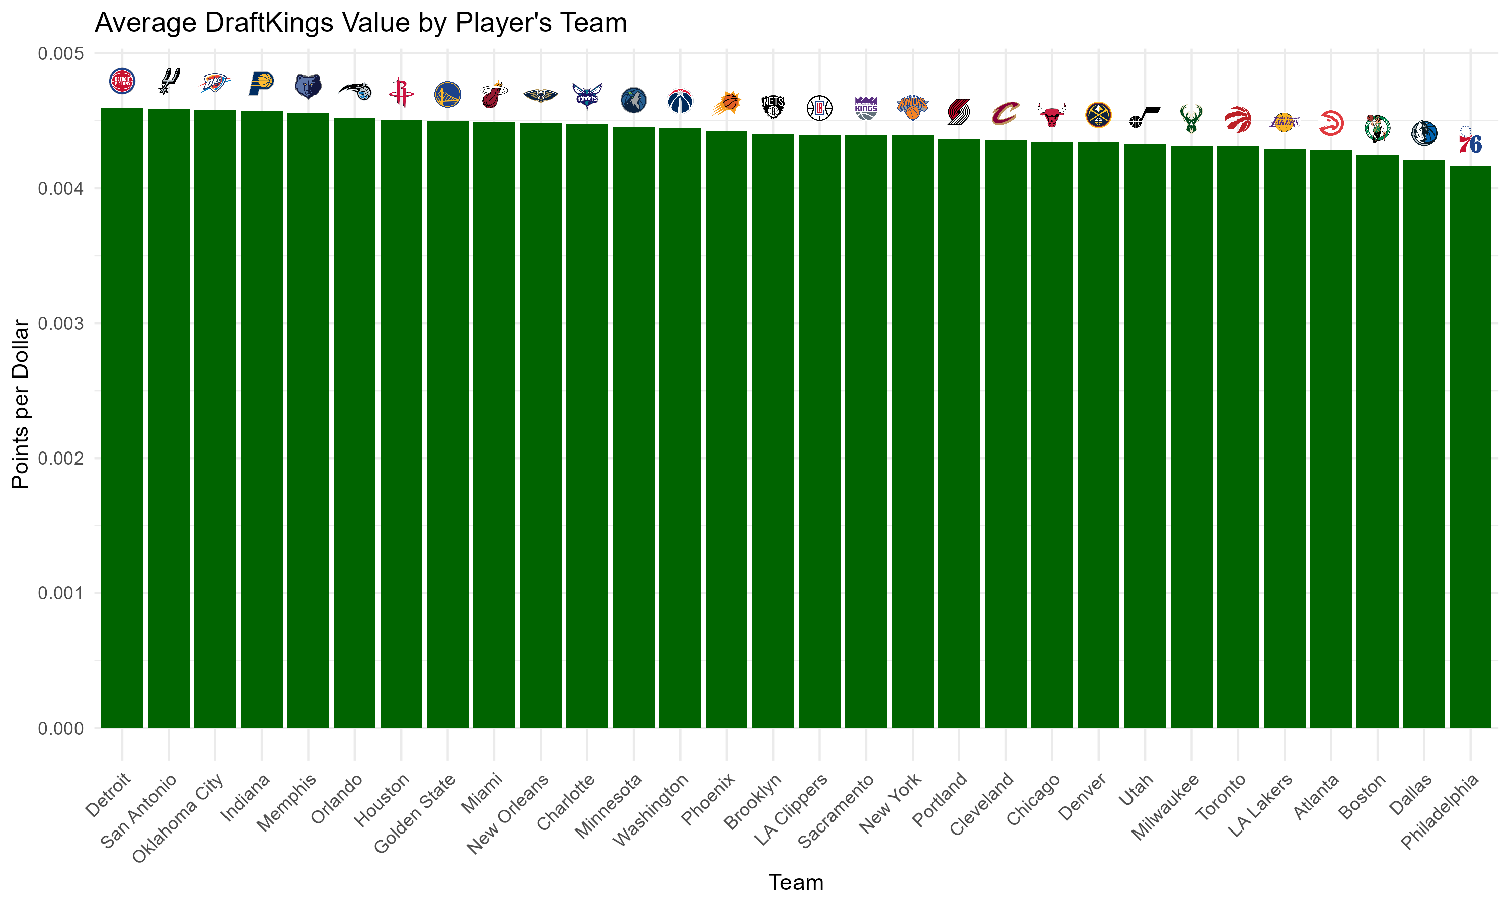
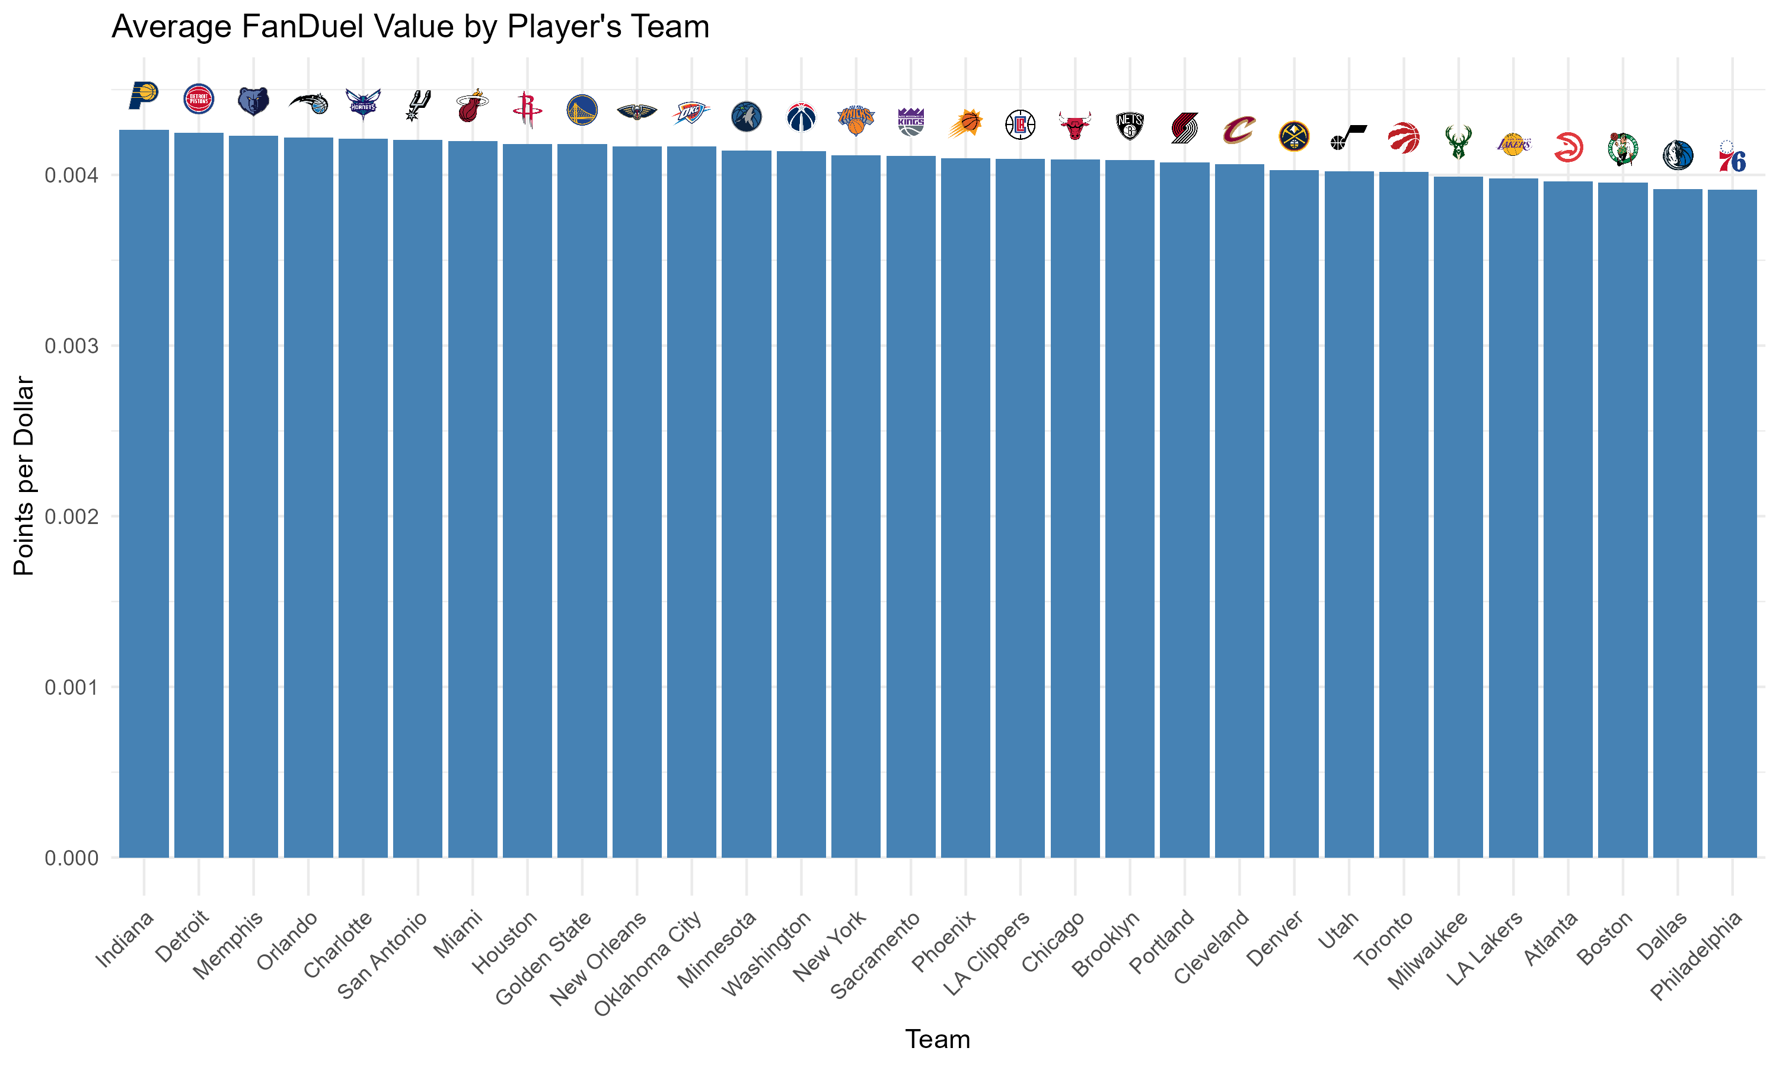
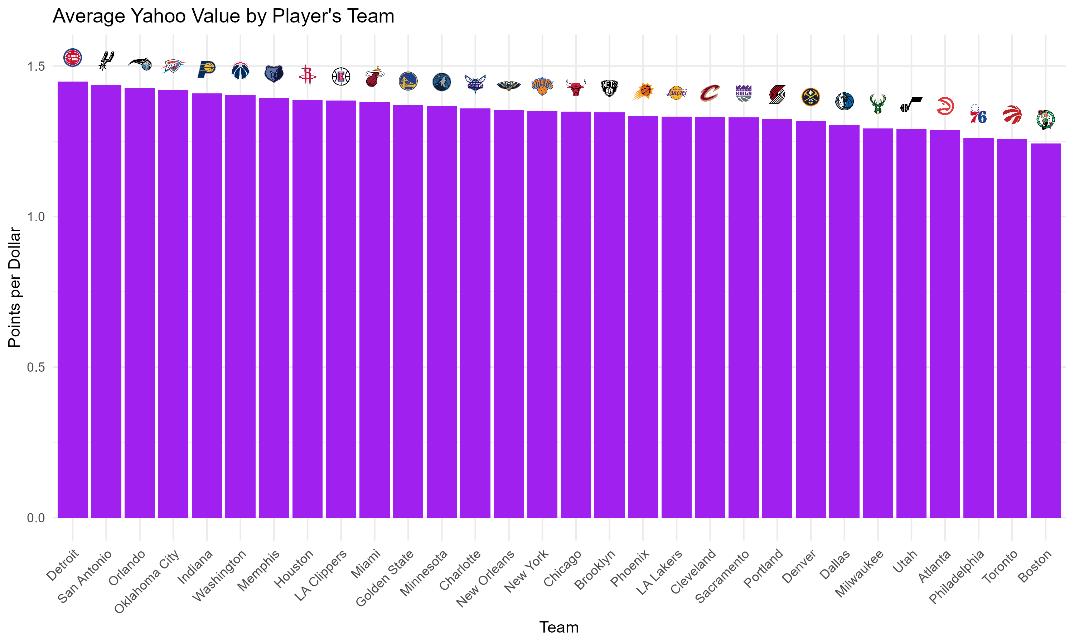
Player Value by Team
To identify teams that add or subtract DFS value to their own players, we calculated points per dollar (ppd) for each player on DraftKings, FanDuel, and Yahoo by dividing their fantasy points by their salary. We then grouped the data by the player’s own team and averaged the ppd to get a team-level measure of value.Teams where players consistently provide high DFS value across all three platforms (DraftKings, FanDuel, Yahoo) include Detroit, San Antonio, Indiana, Orlando, Oklahoma City, and Memphis. These teams appear near the top in each ranking, suggesting their players regularly outperform salary expectations — likely due to underpricing, high usage, or outperforming roles. On the other end, teams like Philadelphia, Boston, Dallas, and Toronto consistently rank near the bottom, indicating a DFS tax — their players tend to return fewer points per dollar, perhaps due to inflated pricing or shared offensive roles.

Slide 12
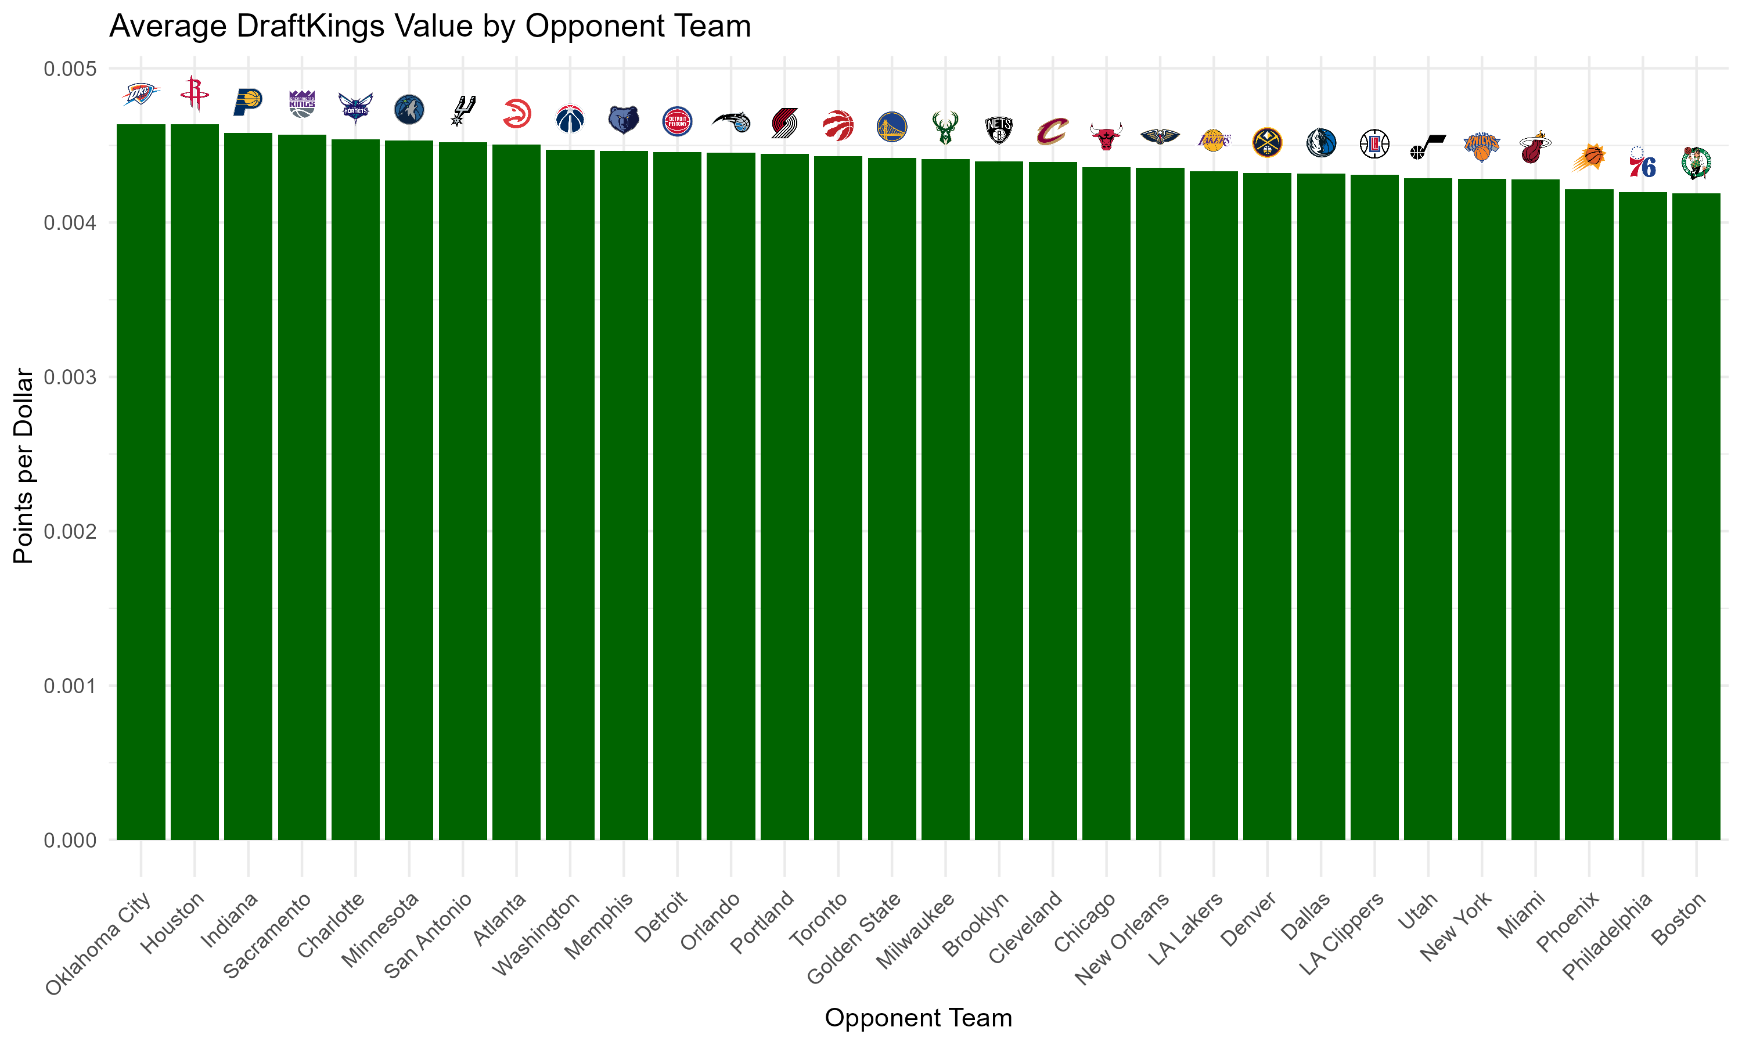
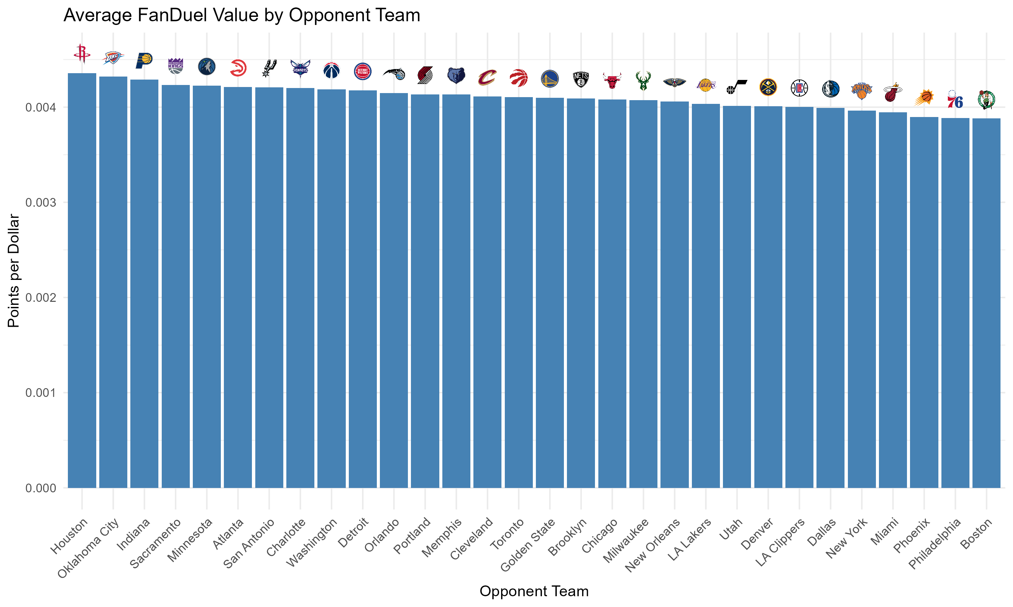
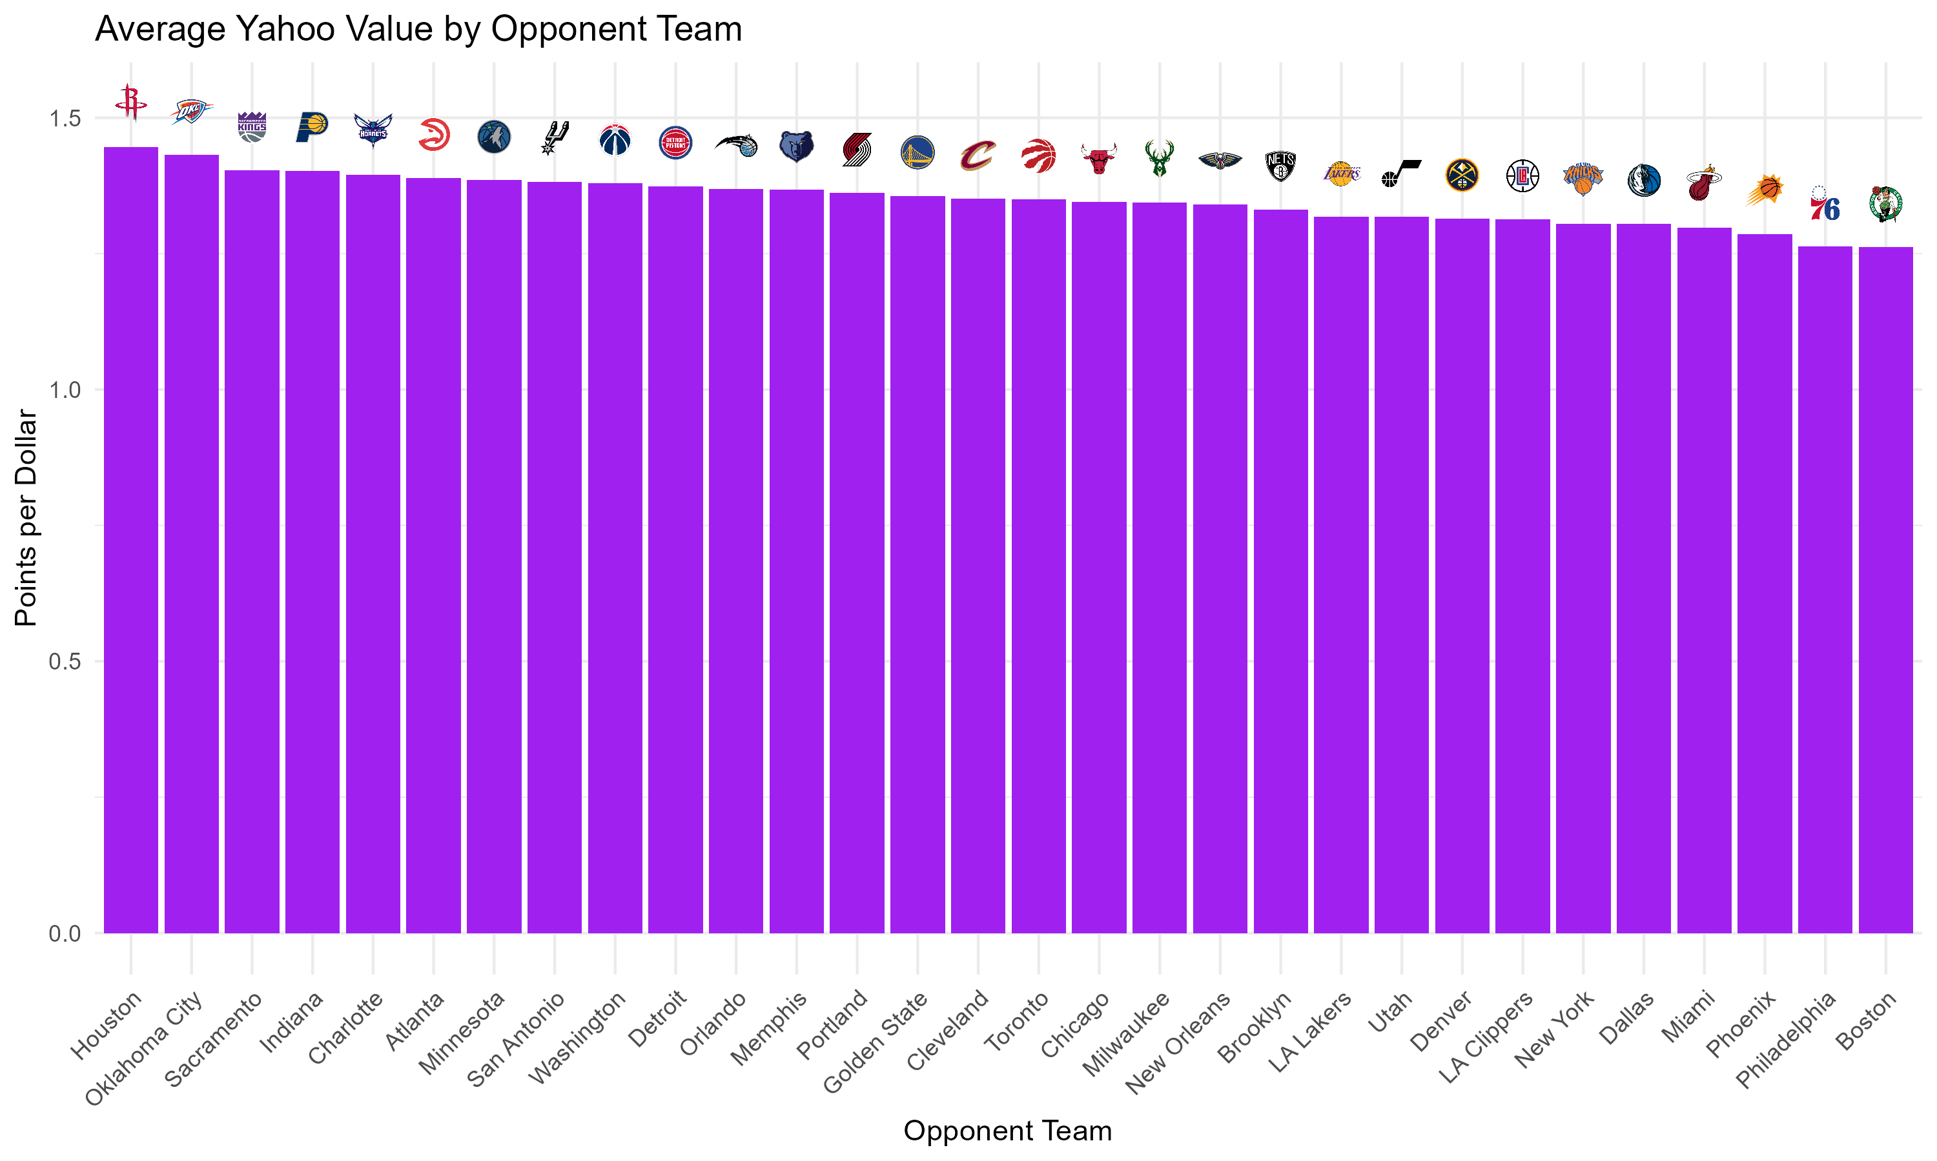
Player Value by Opponent
When looking at teams that consistently give up value to opposing players — making them ideal targets — the most exploitable across all platforms include Houston, Oklahoma City, Indiana, Sacramento, Charlotte, and Minnesota. Players facing these teams tend to score well above their cost, making them smart DFS picks. Conversely, teams like Boston, Philadelphia, Miami, and New York consistently rank at the bottom in opponent value, meaning they suppress DFS production — a signal to be cautious when selecting players going against them.

